Slide 1


Capstone Project
Merlin Gutter, Yidi Geng, Vladislav Perevalov, Antony Britto
Canadian travel data
Data Mining & Business Intelligence, Burlington, November 2022

Slide 2




TEAM
Merlin
Gutter
Yidi
Geng
Vladislav Perevalov
Antony Britto

Slide 3
AGENDA
1.
Dataset & Data Clean-Up
2.
Countries
3.
Continents & Regions
4.
Weather Influences

Slide 4

PROBLEM STATEMENT
How did COVID impact travel to Canada?
What are the main Influencing factors in predicting travelers from one country?
As a cold Country, are there more travelers in the winter or in summer?
1
2
3

Slide 5

Dataset & Data Clean-Up Countries Continents & Regions Weather Influences

Slide 6
Dataset & Data Clean-Up
Database Insights
INSIGHTS
CRITERIA
14
Country of residence | Visitors by country/ continent
# of Visitors | Monthly breakdown of total no. of visitors
Individual Datasets
294
Individual Datapoints per dataset
SOURCE & USAGE
Data was collected by the Canada Border Services Agency (CBSA) and supplied to Statistics Canada to perform analyses on tourism.
Since the start of data collection, various government and private organizations used the data to perform analysis to produce data on commerce and tourism between Canada and other countries
01/72 – 05/22
Time of data collection
Source: Pecar, 2022

Slide 7

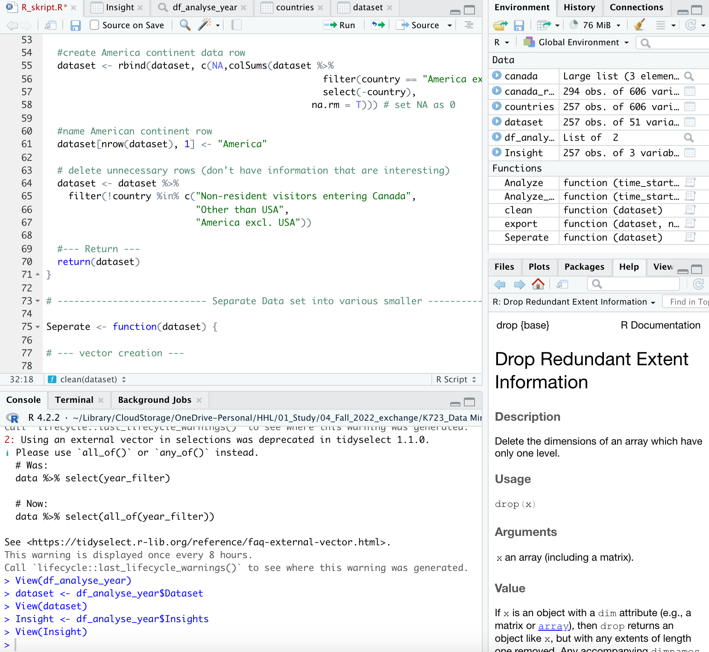


Dataset & Data Clean-Up
Data Cleanup
Import
CSV File from Kaggle
Raw Data
606 Columns
294 Rows
Rename & Aggregate
Rename countries and aggregate them in corresponding categories
Order & Separate
Separate the dataset into subsets with 3 hierarchy levels
Continents
1 Dataset
6 Continents
Continents
6 Datasets
5-6 Regions
Continents
1 Dataset
257 Countries
Analyze
Implement filter criteria in columns (time) and rows (continents/ countries) and calculate SUM & AVG
Analyzed
2 Datasets
Export
CSV File from R with specific dataset

Slide 8
Dataset & Data Clean-Up Countries Continents & Regions Weather Influences

Slide 9



Countries
Top 5 origins of travelers
TOTAL VISITORS
AVERAGE YEARLY VISITORS PER CAPITA
#1
USA
1,556,649,749
11.03%
USA | 90%
UK | 2%
France | 1%
Japan | 1%
Germany | 1%
#2
UK
31,017,738
1.04%
#3
Fance
15,478,598
0.51%
#4
Other
6%
Japan
15,278,489
0.24%
The top 5 countries contribute to 94% of travelers
USA alone provides 90% of the total travelers between 2000 and 2021
#5
Germany
10,735,398
0.26%
Source: Our World in Data, 2022

Slide 10
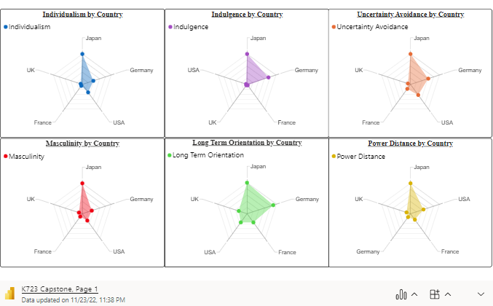
Countries
Country Comparison using Hofstede’s metrics
DEFINITIONS
Individualism
Individuals are expected to take care of themselves and their families
Indulgence
Gratification of human drives related to enjoying life and having fun.
Uncertainty Avoidance
The degree of comfort with uncertainty and ambiguity.
Masculinity
A preference in society for heroism, assertiveness, and material rewards for success.
Long Term Orientation
The fostering of virtues oriented towards future rewards.
Power Distance
The degree to which people society relate to each other on a hierarchical scale.

Slide 11
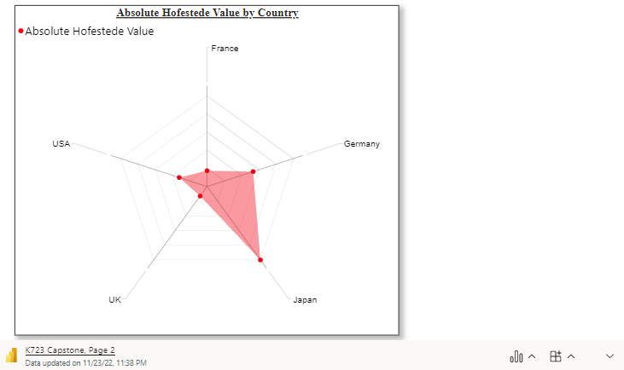
Countries
Country Comparison using Hofstede’s metrics
INSIGHTS
USA
Despite common boundaries and Historic roots, USA and Canada have more cultural dissimilarities than expected, except for Indulgence.
UK and FRANCE
Among the 5 countries, UK and France have the highest similarity, except for Long term orientation. France has a slight difference in Power distance.
GERMANY
Although Germany has some history with Canada, they have the 2nd largest difference in Hofstede’s metric with Canada, especially in Indulgence, Long term orientation and uncertainty avoidance.
JAPAN
With the largest difference in Hofstede’s values, Japanese and Canadians don’t see eye to eye in many aspects of day-to-day life.

Slide 12
Dataset & Data Clean-Up Countries Continents & Regions Weather Influences

Slide 13
Continents & Regions
Insights Behind Trends and Key Movements
Total Visitors per Continent over time
-18%
50,0000
+22.5%
+2.9%
45,0000
40,0000
35,0000
30,0000
25,0000
5,0000
0
1972
1973
1974
1975
1976
1977
1978
1979
1980
1981
1982
1983
1984
1985
1986
1987
1988
1989
1990
1991
1992
1993
1994
1995
1996
1997
1998
1999
2000
2001
2002
2003
2004
2005
2006
2007
2008
2009
2010
2011
2012
2013
2014
2015
2016
2017
2018
2019
2020
2021
1979 - 1980
1981 - 1982
1990 - 1999
22.5% increase
Oil price increase
Inflation rate surge to 22%
Limited budget to travel
18% decrease
Stricker monetary policies
A severe economic recession
No budget to travel
Steady increase
A time of strong economic growth
Lower airfares
More politicians supports in Canada lead to recreation, parks and culture became far more sophisticated
Africa
Antarctica and Adjacent Islands
Asia
Europe
Oceania
America
Notes:
Yidi

Slide 14
Continents & Regions
Insights Behind Trends and Key Movements
Total Visitors per Continent over time
50,0000
45,0000
-6.2%
40,0000
-84.4%
35,0000
30,0000
25,0000
5,0000
0
1972
1973
1974
1975
1976
1977
1978
1979
1980
1981
1982
1983
1984
1985
1986
1987
1988
1989
1990
1991
1992
1993
1994
1995
1996
1997
1998
1999
2000
2001
2002
2003
2004
2005
2006
2007
2008
2009
2010
2011
2012
2013
2014
2015
2016
2017
2018
2019
2020
2021
2000 - 2009
2009 - 2014
2019 - 2020
Steady decrease
2001: 911 terrorist attacks
2003: SARS epidemic
2002-2008: significant appreciation of the CAD
The trough in history
The economic crisis in 2008
Sharp drop
COVID epidemic started from early 2020
Less flights, stricter boarder regulations
Africa
Antarctica and Adjacent Islands
Asia
Europe
Oceania
America
Notes:
Yidi

Slide 15
Continents & Regions
Analysis by Continent
SHARE OF VISITORS PER CONTINENT
Africa | 0.3%
Asia | 4.6%
Europe | 7.8%
Oceania | 0.9%
America | 86.4%
Total amount of visitors between 2000-2022 amounted to 658,980,324
Overseas visitors accounted for 15.6% of the total
We have included various quantifiable factors that could provide some explanation as to the distribution of visitors per continent
Notes:
Vlad

Slide 16
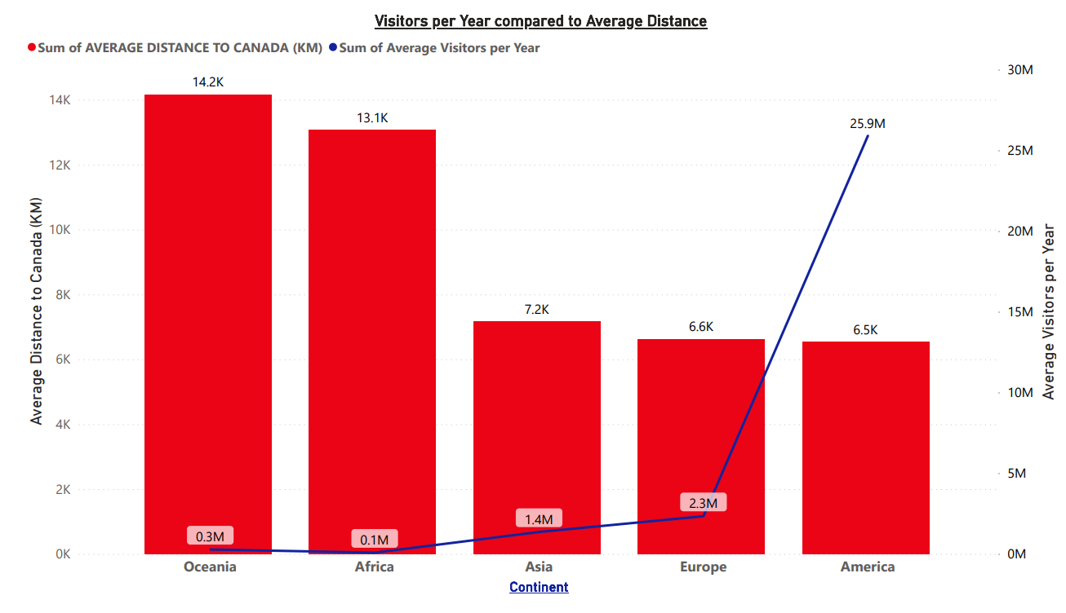
Continents & Regions
Analysis by Continent
Overall relationship can be observed between distance and visitor amount, with the American continent having a large increase due to the U.S.
Notes:
Vlad

Slide 17
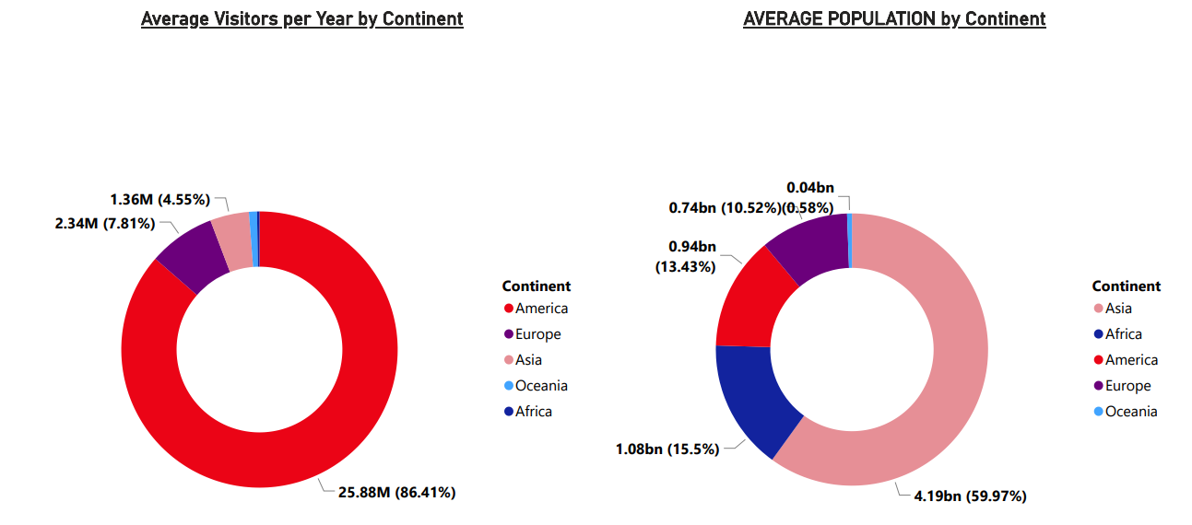
Continents & Regions
Analysis by Continent
While Europe and Oceania are somewhat proportional when it comes to their population and number of visitors, America and Asia are complete opposites, and Africa has a tiny proportion of population versus visitors
Notes:
Vlad

Slide 18
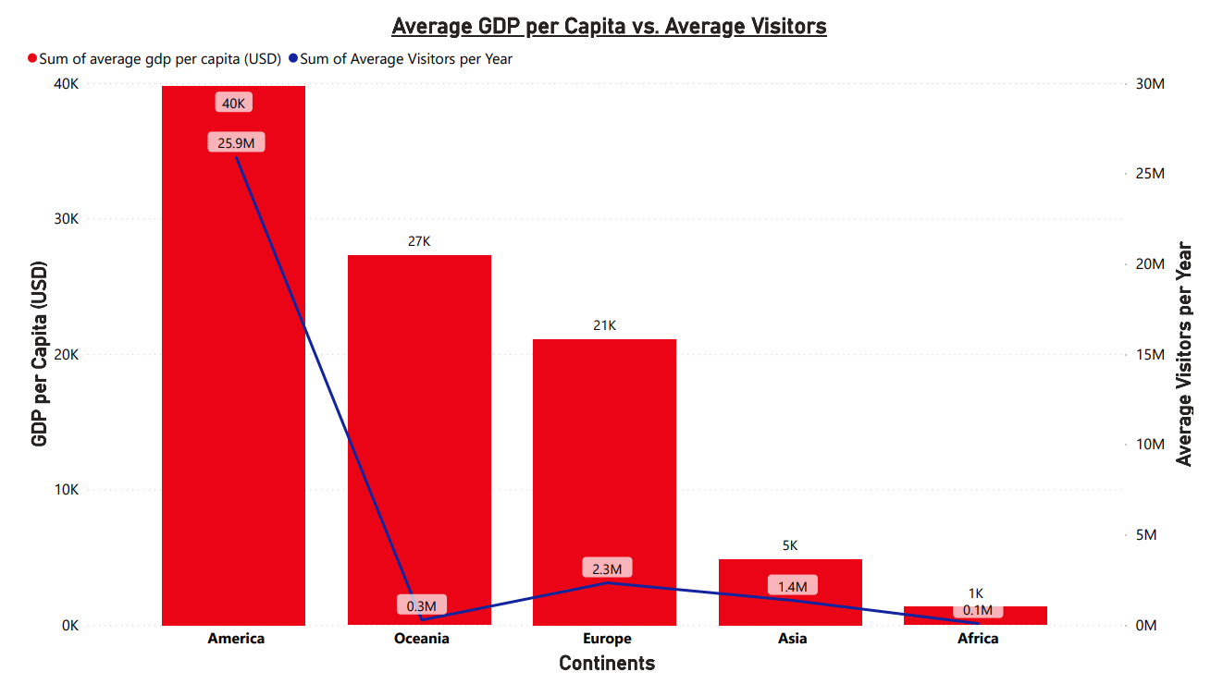
Continents & Regions
Analysis by Continent
Notes:
Vlad

Slide 19
Correlating Influences
AVG Population
AVG Distance
AVG GDP per Capita
30
30
25.5
USA
Average Travelers (MM)
25
USA
Average Travelers (MM)
25
USA
AVG Travelor to Canada in mil
Europe
2
20
20
15
15
1.5
Asia
10
Oceania
10
1
Americas
Europe
Oceania
5
Africa
5
Africa
0.5
America excl. USA
Asia
America
Oceania
0
0
Asia
0
Africa
0
1
2
3
4
5
0
5
10
15
0
5
10
15
20
25
30
35
69.290
Europe
Average Population (Bn)
AVG Distance to Canada in k
AVG GDP per Capita in k
Medium negative Correlation
While Europe and Oceania are somewhat proportional when it comes to their population and number of visitors, America and Asia are complete opposites, and Africa has a tiny proportion of population versus visitors
Strong negative Correlation
Overall relationship can be observed between distance and visitors amount, with the American continent having a large increase due to the U.S.
Strong positive Correlation
The average of the continents can’t be compared to one country. The Influence of The USA on the correlation is therefore very strong.

Slide 20
Dataset & Data Clean-Up Countries Continents & Regions Weather Influences

Slide 21
Weather Influences
Seasonal Differences
OVER CONTINENSTS
NORTHERN REGIONS IN CONTINENTS
27%
359.683.635
209.756.134
27%
% of total is difference btw. Summer & Winter
% of total is difference btw. Summer & Winter
SOUTHERN REGIONS IN CONTINENTS
Africa
Asia
Europe
Oceania
America
Insights
Across all continents, there are significantly more travelers coming in during summer than winter
Insights
~2/3 of tourists come in summer & 1/3 in winter resulting in the assumption that Canada is a country to visit as Winter & Summer destination
33%
% of total is difference btw. Summer & Winter
It seems that the northern regions not only travel more often to Canada but also more in the winter times than southern regions.
Summer
Winter

Slide 22
KEY TAKEAWAYS
RECOVERY
Covid 19 is not a barrier of travel anymore
As observed the number of travelers will increase again in the coming months
The main factor is distance and culture – likely these will stay stable also in future
Secondary factors are GDP and Population
Minor factors which can’t be quantified are visa regulations and Canada's border and airport quantity per continent
INFLUENCING FACTORS
TIME OF TRAVEL
Canada is mainly a destination for summer travel with a decent amount of winter tourists

Slide 23
References

Slide 24
references
References
Our World in Data (2022). Population by Country. Retrieved November 23, 2022, from https://ourworldindata.org/grapher/population-by- country?tab=table
United Nations. (2021). List of continents by GDP per capita. Continents by gdp per capita 2021 - StatisticsTimes.com. Retrieved November 22, 2022, from https://statisticstimes.com/economy/continents-by-gdp-per-capita.php
Feed, G. (2022). Distance Calculator. Distance between countries, closest distance between borders, airplane flight time, Distance Chart. Retrieved November 21, 2022, from https://distancecalculator.globefeed.com/Distance_Between_Countries.asp
UN. (2022). World population prospects - population division. United Nations. Retrieved November 21, 2022, from https://population.un.org/wpp/
Pecar, R. (2022). Visitors to Canada by Country of Residence. Kaggle. Retrieved November 23, 2022, from https://www.kaggle.com/datasets/russellpecar/visitors-to-canada

